Slide 1
Part 3: Replication, p-values and sample size

Slide 2
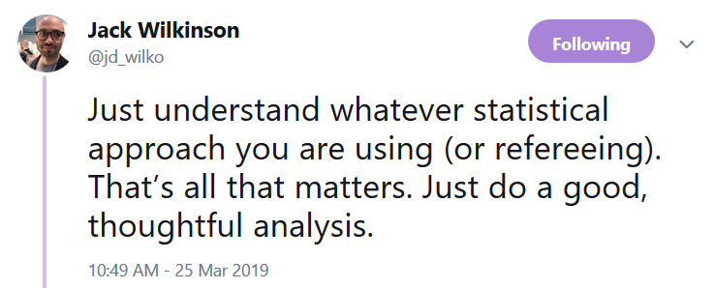

Slide 3
INTRODUCTION

Slide 4
How many samples do I need?
How to think about sample size
Calculations for precision and power
Where do we get our inputs
Unit of experiment and its implications
Application to microbiome work
Revision of hypothesis testing / estimation

Slide 5
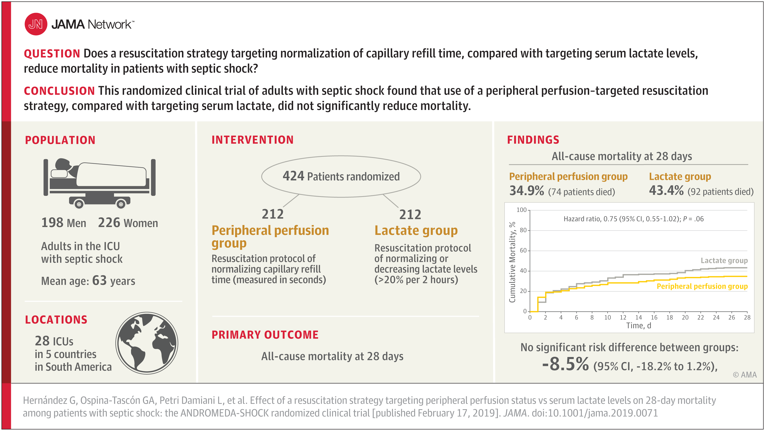
A recent study
Exercise 1

Slide 6
Exercise 2 – (adapted from a real study) How many people with COVID have virus in their stool?
Research project:
Consecutive COVID patients will be recruited, we will test their stool samples for COVID virus and report the proportion of patients with detectable virus in their stool.
How many patients do we need?

Slide 7
Exercise 2 discussion
Sample size by simulation. The easiest(?) but maybe most effective way!
Simulate some realistic data
Conduct your planned analysis
Is your answer precise enough??
What did we need to know?
What exactly is our research question and our purpose
What analysis will we do?
What does ‘realistic’ data look like
This is not an exact science

Slide 8
What is the optimal sample size?
The smallest sample size that gives you a good chance of meeting your scientific objective.
There are different kinds of studies answering different kinds of question. Most (all?) can be expressed in terms of:
Hypothesis testing or (leading to a p-value)
estimation of a quantity (leading to an estimate and standard error)
Hypothesis testing – sample size determined by power
For estimation – sample size determined by required precision
(exploratory, discovery, process control –can be thought as testing or estimation)
How good is good?
How much risk of failure are you willing to accept?

Slide 9
So what exactly is your scientific question?
The sample size question:
How many samples do I need….
……….to meet my scientific objective.
Ie to answer the question you set out to answer.
Two important things you need to know!
What is my scientific objective?
When will I know if I’ve met my objective
We want to describe the gut microbiome of older adults. How many samples do we need?
What is your research question?
To describe the gut microbiome of older adults
Can you be more specific…
What do you mean?
…..what exactly are you going to learn from your data…

Slide 10
“I want to describe the microbiome of older adults in Norfolk”
How will you determine when this objective is met?
What is the distribution of alpha/beta diversity?
Which are the most common species?
What is the prevalence of…? (How precise?)
How does diversity vary with age?
What is going on in specific sub-populations?
Which rare species do we find? (How rare?)
How do drugs affect species/diversity
Etc…
These questions must be specified to design your study.
Sometimes it’s not obvious and needs some work
Every questions needs a different analysis (possibly a different design) and a different sample size
Bigger sample =
More precise answers to more questions
Specifying the questions and the required precision:
A bit more work for you ☹

Slide 11
Make sure your calculation aligns with your real aims.
A group wanted to see if their dietary intervention affects alpha diversity of the gut microbiome
We calculated they would need 20 people
But then proposed to
Use machine learning to identify ‘responders’ to treatment
Do detailed comparisons of microbial compositions
Correlate microbiome with urinary metabolites
Etc…

Slide 12
Subgroup analysis and personalised medicine needs bigger studies
We want to test whether a treatment is effective (overall) in mice
The research plan suggests the investigators will also test for sex differences in the treatment effect (do male vs female mice respond differently)!
This is a different question and needs a different sample size calculation

Slide 13
Exercise 3 – P-values and sample size by simulation
Goal: Estimate the effect of our dietary supplement on mouse gut diversity.
First, we’ll run preliminary study of the intervention, to illustrate the effect of sample size on precision of estimates and reliability of p-values.
Then we’ll consider how many participants we really need for this study.

Slide 14
What did we need to know
To calculate power, we set:
Research question, design and planned analysis
True effect size
Standard deviation
Critical p-value threshold –
assumed p<0.05, when might this be different?
Then, by varying sample size we varied the power.
We can work out the sample size needed for a given power,
Or the power achieved for a sample size.
Or the smallest effect detectable at a certain sample size and power.
We needed to know all of this before calculating the sample size!!

Slide 15
Exercise 3 discussion
How precise was the estimate of effect with 10 mice per group?
How does this change with increasing sample size?
How reliable was the p-value across experiments?
Did the experiments agree or disagree with respect to the efficacy of the treatment?
How many participants would be ‘enough’ to reliably detect the effect that we introduced?
How does this change if we change the size of the effect?
How does this change if the mice become more variable?

Slide 16
Define power
For a hypothesis testing experiment
The power of a study is the probability the experiment will lead to a ‘significant’ finding, if an effect truly exists to begin with.
This is what we were calculating with the simulations
What did this depend on?

Slide 17
Hypothesis testing and types of error
For any given experiment: The null hypothesis is either true or false.
If the null hypothesis is true (no effect)
You might get a false positive (type I error – Prob=size of the experiment)
You might get a true negative
If the null hypothesis is false (there is a real effect)
You might get a true positive (Prob = power of the experiment)
You might get a false negative (type II error)
Remember: experimental results are random.

Slide 18
Power and size (typical values)
Power of 80%:
“If the effect is there (at least X size), then my experiment has an 80% chance of detecting it as statistically significant”
Perhaps better: “I have a 20% chance of missing a real effect”
Size of 5%:
“If the effect is not there, then my experiment has a 5% chance of reporting a (false) positive”
How do we set the size of an experiment?
We fix the size by setting the critical p-value (usually p<0.05) for our analysis

Slide 19

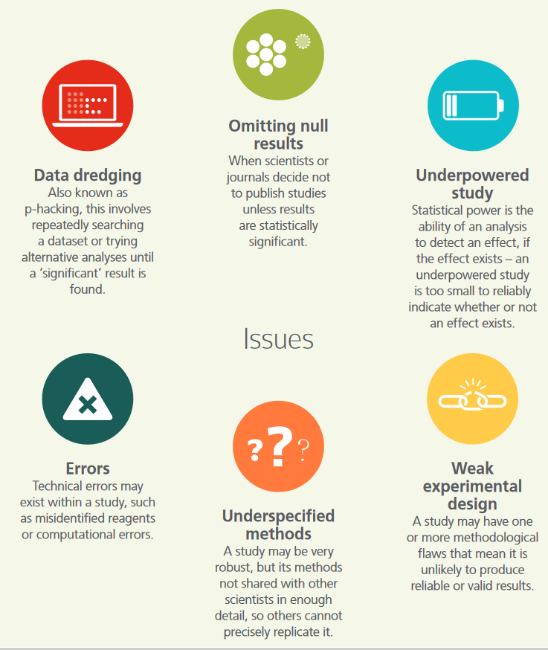
Funders scientific integrity review

Slide 20

…what about ‘exploratory’ / inductive research
It’s OK, it’s only an exploratory study
When do you need a sample size calculation?
When don’t you need a sample size calculation?
You should always have a good rationale for your sample size
What is the purpose of exploratory research?
To my mind exploratory research should be sensitive.
What’s the point of screening for associations if you’re going to miss most of them?
Thoughts?

Slide 21
….what about feasibility / pilot / proof of concept studies?
What is the aim of a pilot study?
Get estimates for reliability and variation
Test feasibility of protocols
Get initial estimates for effect size
Screen out ‘useless’ interventions
Show change in a proximal biomarker
Get preliminary data for grant application
Usually not to demonstrate something conclusively
Make sure your study is designed to meet its own objectives
Make sure you are genuinely learning things you don’t know, and that will be helpful
May not need a power calc but does need a rationale for sample size.
Have you conducted a pilot study?
What did you learn from it?
Did you meet your objectives?

Slide 22
What about microbiome research?
Microbiome research is characterised by:
High dimensional outcomes
Unclear target effect sizes
Often very exploratory
Ambiguous hypotheses
But increasingly we have..
Good prior data
Better analysis pipelines
Improving methods for principled sample size calculations

Slide 23
Summary 1 : what is statistical power?
Power is the probability that your experiment will demonstrate an effect when it is really there. (the ‘sensitivity’ of your experiment).
With an underpowered study:
More chance of missing real effects ( type II error prob = I - power)
More chance that your ‘discoveries’ are false!
(because the rate of false positives stays constant at 5%)
Underpowered studies can be worse than useless (kill a good idea, or generate noise, often uninterpretable).
Exploratory and confirmatory studies should be designed to meet their own objectives

Slide 24
Summary 2: Required sample size
The sample size we need is the smallest number that gives us a good chance of answering our research question well enough.
(This might be an estimation or a testing question)
Simulation is a very good way to see how our results are likely to vary with sample size!

Slide 25
Exercise 4/5 Why do scientists often ignore sample size issues?
Because this is the typical logic:
Do experiment
Do analysis
If p>0.05 – we have proved there is no effect,
if p<0.05 – we have proved there is an effect
What’s wrong with this logic? Can you correct it?

Slide 26

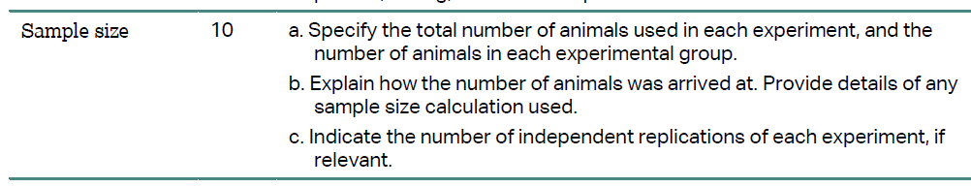
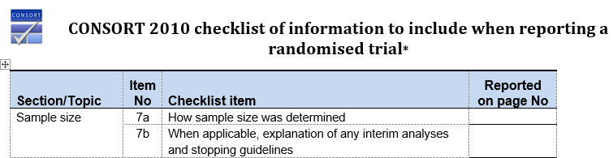
Purpose of a sample size calculation
Plan an efficient and effective study
Convince funders/ethics etc that your proposals are feasible
Reassure readers that your results are credible
Give you faith in interpreting your positive and negative results
Think through your analysis

Slide 27
Calculating sample size by considering precision

Slide 28
Two paradigms for inference -> Two approaches to sample size calculation:
Based on power:
From ‘hypothesis testing’ paradigm
“eg if this effect is real then I want to be at least 80% sure that I won’t miss it at p<0.05”
Based on precision:
From ‘estimation’ paradigm, eg:
“I would like my standard error to be less than 0.25 units”

Slide 29
Calculating sample size by precision
Suppose we don’t have a testable ‘hypothesis’, and are targeting estimation of a parameter instead
What proportion of people have COVID in their stool sample?
What is the correlation between caloric intake measured by food diaries and 24 hour recall tests?
How many samples do we need?
Neither are ‘tests’, neither has ‘power’.

Slide 30
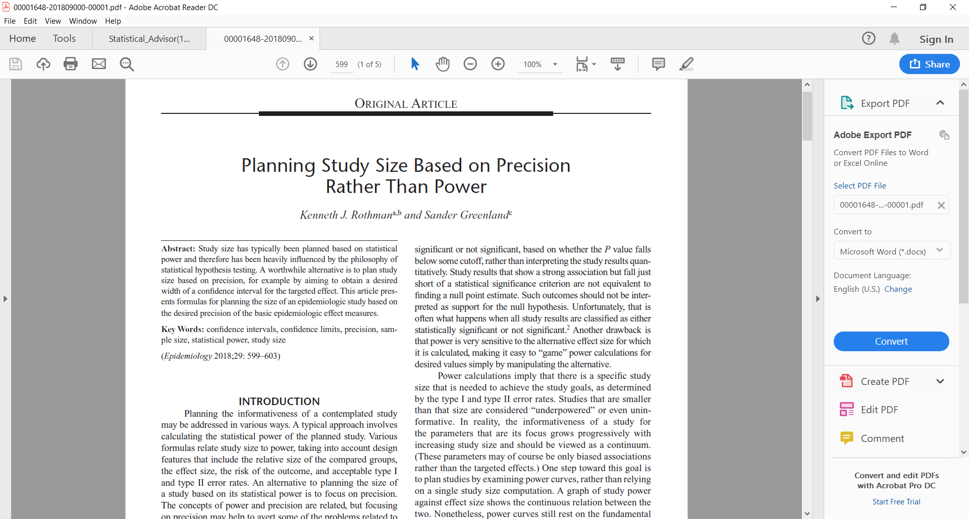
A relatively new idea (2018)
But very simple
As we move away from hypothesis tests, this will become more common

Slide 31
‘precisely’ package for R
Base R can be supplemented by ‘packages’ to do almost any analysis.
If somebody has ever needed to do anything (statistical)…
… there is probably an R package for it.
Precisely can estimate sample size based on precision for odds ratios, rate ratios, risk differences etc. Based on Greenland and Rothman (2018). Although the formulas aren’t too complex.
https://github.com/malcolmbarrett/precisely (R package)
https://malcolmbarrett.shinyapps.io/precisely/ (Shiny app)

Slide 32
Can we use gen AI for this?
Suppose we want to estimate a correlation of 0.5 with a confidence interval of +- 0.1
How many samples do we need?

Slide 33
Sample size by considering power

Slide 34
Sample size by power calculation
With the “hypothesis testing” paradigm (using p-values for inference)
The power of a study is the probability that:
you will detect an effect as (statistically significant)
if it is really there
This is the same as the probability that the 95% CI will exclude 0
What factors does power depend on?
(or whatever value means no effect).

Slide 35
What determines statistical power
For a given study, power depends on:
Precision of experiment (standard error of the outcome)
In turn depends on precision of outcome measures (standard deviation) and sample size.
Size of the effect we are looking for
Precise (large) studies can detect small effects.
Imprecise (small) studies can only detect big effects.

Slide 36
So any statement about power must depend on the size of the effect you are trying to detect.
E.g. To detect an effect of a weight loss intervention..
If it is going to cause a 10kg loss on average, then I might need very few people
If it is going to cause a 100g loss on average then I will need many more people.
Which effect size should I choose for my calculation?
Turns out a weight loss intervention is only valuable if people lose 3kg or more.

Slide 37
If you’re still not happy with this
Consider testing difference in average heights between:
Adults (~168cm) and Ten year old children (~138cm)
Men (~175cm) and women (~161cm)
Dutch men (~183cm) and English men (~179cm)
Required sample size depends enormously on the real underlying effect size!
(Lets do it analytically and by simulation - height has a s.d. of about 6cm
how many samples would each of these need?)

Slide 38
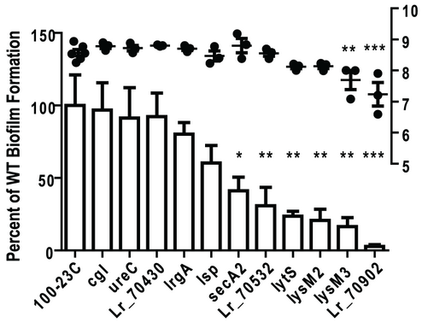
An example from real data:
How does sample size vary with the ratio of a outcome between two groups:
(To use ratios, I did the power calc on a log-scale as the data looked multiplicative)

Slide 39
Examples and Exercise 6: pwr.t.test() function to calculate power and sample size using R.
Power by simulation in the mouse example.
Or it can be done analytically with simple formula implemented in R.
https://www.youtube.com/watch?v=ZEFSUm6JNQ0

Slide 40
Cohens d
It should be obvious now that what really matters for power is the ratio of the effect size to the standard deviation
(Because I could just change the units of the true difference and sd)
This is called ‘Cohens d’ statistic or ‘standardised effect size’.
Sample size calculation software will often use this as an input instead of needing both effect size and standard deviation.

Slide 41
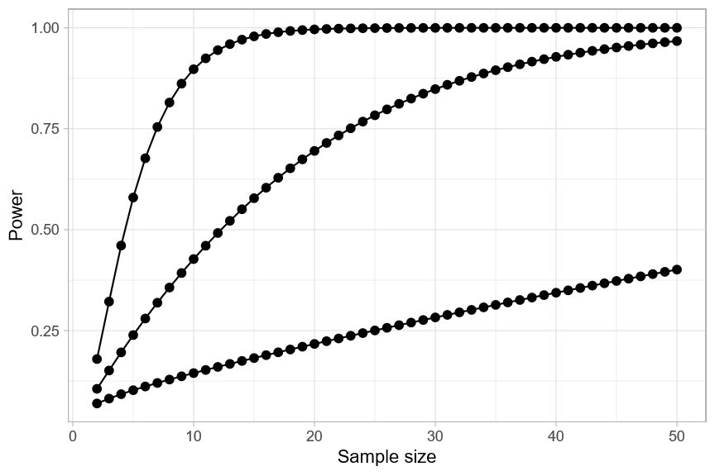
Power curves
For a given effect size and design, we can plot power against sample size. This is a power curve of a study:
Power curves for one sample
one-sided t tests
Cohen’s d=1.0
Cohen’s d=0.5
Cohen’s d=0.2

Slide 42
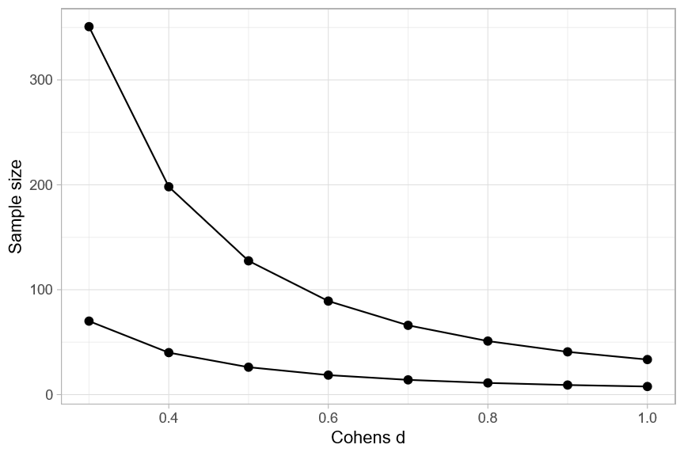
Power curves
Or we could plot the smallest effect size detectable at (say) 80% power and 5% size against the sample size.
Exercise:
Typical animal study?
What is the smallest detectable effect size with N=10 per group in a parallel groups design?
Two-sample, two-sided
One-sample, one-sided

Slide 43
Summary Power and sample size calculations in practice
To get sample size specify: (for a given design, and test)
Effect size, (variance between groups)
Variance of outcome measure, (variance within groups)
P-value (size) (or some other measure of false positive eg false discovery rate)
Power
To get power:
design, effect size, variance, p-value (size) and sample size
To get minimum detectable effect size:
design, variance, p-value (size), sample size and required power
For a given design: with any three of these we can calculate the fourth
Power
(probability of detecting effect if real)
Standardised Effect size
(Cohens d or Cohens h etc)
Risk of false positive
(size or FDR)
Sample size
(experimental units)

Slide 44
Computational approaches
Analytical calculations (eg G*Power, R, ‘pwr’, ‘superpower’ etc packages)
For most simple designs these are usually available.
Or online apps
Simulation (eg R ‘simr’ package, or code it yourself for flexibility)
For more complex designs you can estimate power by simulation
Gives you greater control / understanding, but sometimes harder to do

Slide 45
Standardised effect sizes: eg Cohens d, Cohens h
From exercise: for this design all that matters is:
effect / s.d.
(Standardised) effect size
Standardised mean difference (SMD)
Cohen’s D statistic
(Signal to noise ratio)
Exercise:
Cohen’s H statistic for comparing two proportions
ES.h() function from pwr package in R will give you the corresponding ‘effect size’ for comparing two proportions
ES.w1() and ES.w2() for chi-squared comparisons.

Slide 46

Video! Choosing the effect size Daniel Lakens on power and sample size
https://www.youtube.com/watch?v=Lr-i4Ugoc5M
https://www.youtube.com/watch?v=XhfkodpyIsw
Also see Lakens’s ‘statistical inferences’ on Coursera

Slide 47
But my study isn’t just a simple two-mean or two-proportion comparison…
OK – but it’s possible we can:
Reframe the main hypothesis in this way,
Find an analogous approach and package for your design
Or apply a simulation to find the right number
But the logic is the same!
Under reasonable assumptions, will I be able to estimate my effect with enough power/precision
Is the signal to noise ratio sufficient?

Slide 48
Using common sample sizes from previous work
OK if
Sample size in previous work is properly considered
Common in medical work, less common in bench or animal work
Your outcome measures, goals and populations are similar
Will still need careful justification
Not OK if
Just comes from habit with no rationale
In a field where sample sizes are usually too small
Your outcomes are different, or your population is very different

Slide 49
Finding inputs for power calculations

Slide 50

The elephant in the room
All this depends on knowing stuff we don’t know
What is the residual standard deviation of your outcome measure going to be?
What is the size of the effect you are trying to estimate?

Slide 51
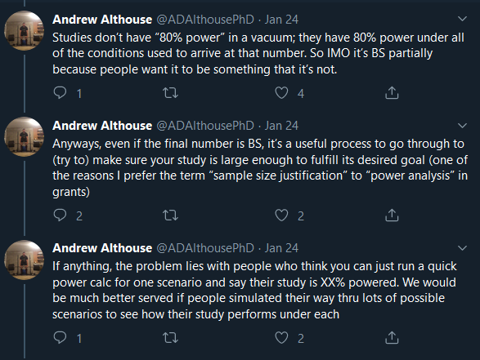
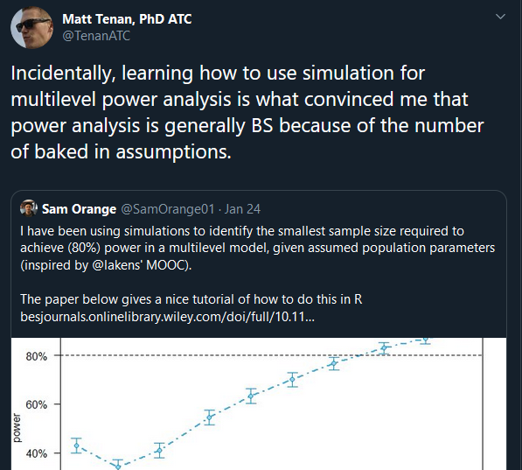
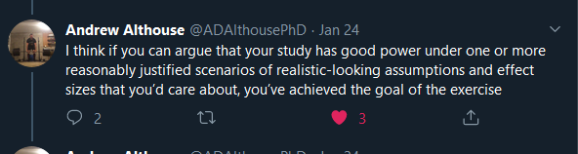
A hot take

Slide 52
Two main things we need to know
What size effect do we want to be able to detect.
How much noise (variance)
Standard deviation of outcome measure
SD of change scores (paired)
SD of outcome (unpaired)
ICC or error structure
Typically from prior data (yours or others)
Minimum important difference
Plausible effect size
Typically from theory / study goals /
May come from prior work
I can’t tell you this!!

Slide 53
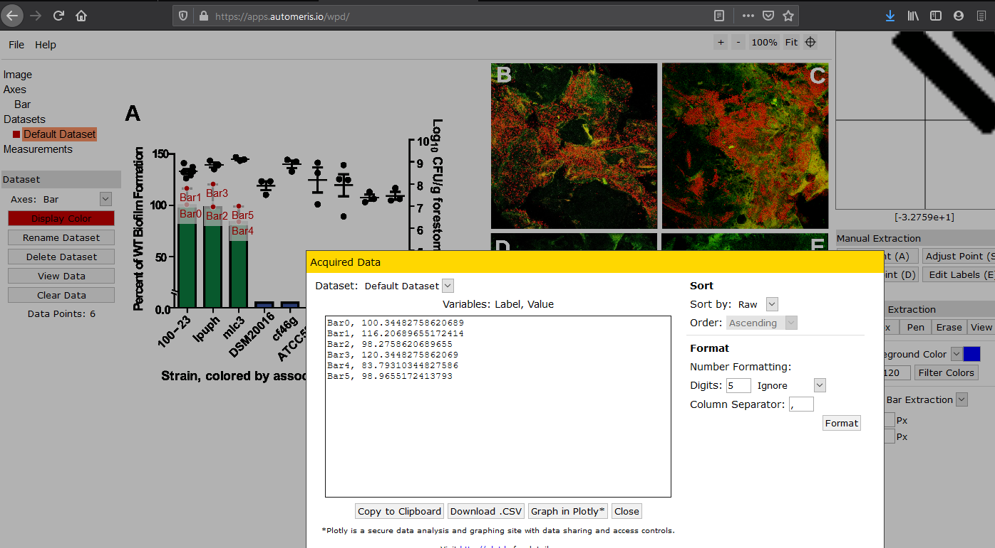
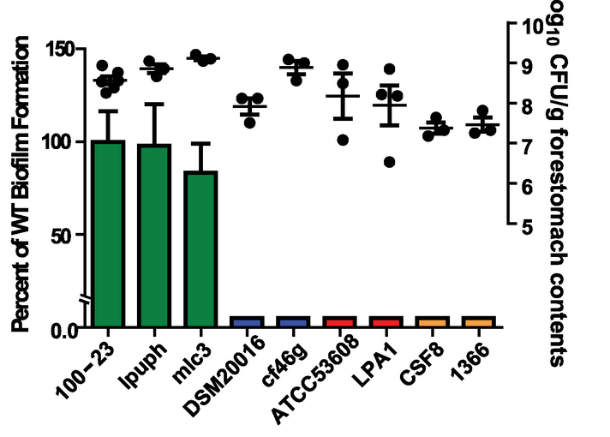
Extracting variances from biology papers

Slide 54
Your own research questions
What is a study you are planning?
What is the outcome?
Where might your prior data on the variance come from?

Slide 55
What effect size to focus on?
If we can get our power curve, we know the risk of failure for each ‘true’ effect size.
How do we choose the effect size for our sample size calculation?
Two approaches commonly used:
Smallest difference of practical interest
Best guess at ‘true’ effect / plausible effect

Slide 56
Example: (stakeholders)
Doctor: “It would only have a clinical benefit for a patient if it improved cognition by 2 MoCA points.”
Researcher: “My pilot study suggested a 5 MoCA point difference!”
Marketing Dept: “I don’t care how different it is, so long as I can say its ‘better’ people will buy it!”
What effect size do we power for??

Slide 57
Researcher:
I just want to find the differences! How many samples do I need!
This question isn’t answerable.
Small differences will only be detected with a big sample size.
Big differences can be detected with a small sample size
We can provide the relationship between the smallest detectable difference and sample size.
So you need to know what your target smallest detectable difference is, or the size of the smallest difference you are willing to miss.
Can be expressed as Cohen’s d.

Slide 58
Rules of thumb
Everything in triplicate
Assumes that there is no variance in response to intervention, differences will be clear cut,
Only replicating to rule out a freak technical error.
If there is known variation in your outcome that is a similar magnitude to your effect size, then not sufficient.
Replicating experiments is weird – do larger blocked experiments instead.
Mead’s Resource Equation
Mainly applied to animal research where no inputs are available.
Suggests keeping the residual degrees of freedom above a certain quantity.
Would be an improvement on many current justifications but..
probably best avoided – if you don’t have good inputs, do a pilot study first.

Slide 59
Mead’s Resource Equation
Mead’s Resource Equation
Mainly applied to animal research where no inputs are available.
Suggests keeping the residual degrees of freedom between 10 and 20
Would be an improvement on many current justifications but still very loose.
Difficult to apply to multilevel work?
Useful for very exploratory pilot work.
Exercise
In a two independent group setting, what effect sizes would be detectable if we used Mead’s Resource Equation to design our studies?

Slide 60
Incomplete data
Sample size recruited N=100
Not every sample will give you usable data
Be realistic with your expectations re:
Drop outs
Failures to collect data
Outliers you might need to exclude
Etc..
Increase your sample size by 10-20%?
Dropped out / died
N=80
Incomplete data / technical error
N=75
Crazy outliers
In the analysis:
N=72

Slide 61
Writing up a power calc.
“Our primary aim is to compare glycaemic index between wild-type and mutant breads, using a parallel groups trial of healthy adults
Previous studies have consistently shown that GI has a standard deviation of 20units in similar populations (citations)
We consider 10 units to be the smallest meaningful difference in GI between breads (citations), and with 50 patients per group our study we will have 80% power to detect a difference of this size
We will recruit 60 patients per group to allow for drop-out”
What was your objectives (comparison and outcome measure)
What were your inputs and why
What is your design/analysis plan
What is the power at your given sample size
What other assumptions have you made?

Slide 62
Experimental design assisstant
https://eda.nc3rs.org.uk/experimental-design-group

Slide 63
What is a replicate?
Avoiding pseudoreplication – making use of matching

Slide 64
Biological replicates, technical replicates?
Replication can occur at different levels of an experiment.
Consider a treatment to promote healing in mouse eyes.
We create lesions on the mouse retina, then randomly assign a treatment to prevent scarring.
We create three lesions per eye, and use both eyes per mouse:
Five cages of mice
Cage has four mice
Mouse has two eyes
Eye has three lesions
Each lesion is measured several times
What is the experimental unit
What is the sample size?

Slide 65
Complex error structure Repeated measures, pairing, clustering etc..
How and why does changing the error structure of an experiment change the nature of a sample size calculation?
Error structure:
What is the source of the variation in your outcome?
How is this distributed among the experimental units?
Eg
What factors affect a mouse microbiome?
Which factors are specific to the animal, and which are shared with its litter mates, co-housed mice, etc..

Slide 66
Pseudo-replication
Misunderstanding the true sample size is a big problem in current bioscience research
Commonly seen in mouse experiments, but can occur whenever we have repeated measured per experimental unit
Technical replicates
Repeated measures (longitudinal data)
Nested structure
Key issue: errors are no longer independent

Slide 67
Unit of experiment
Sample size is the number of the units of experiment
Experimental studies
The smallest unit to which a treatment can be individually allocated
Observational studies
The smallest unit that can be independently sampled

Slide 68
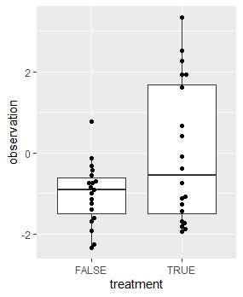
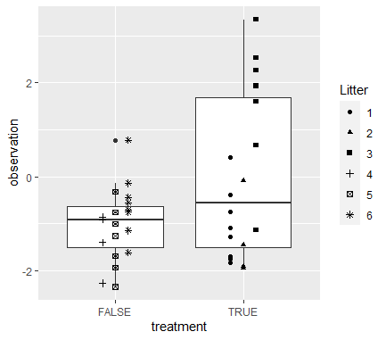
Example: Ignore clustering at your peril!
(Simulation closely following some real data)
p-value = 0.02836
p-value = 0.438
Significant effect?
No evidence for an effect
What is the experimental unit, and why?

Slide 69
Why is this an issue?
Clustered observations provide less information than completely independent observations.
Let’s work through this..
Consider a study to compare neural function between two groups of people (Rheumatoid arthritis vs controls)
Measuring their retinal thickness.
How should we proceed?
Measure one eye only?
Both eyes?
How should we analyse the data?
How much more information do we get by measuring both eyes?

Slide 70
Power and sample size for
multiple endpoints,
‘omics studies,
more complex analyses

Slide 71
Multiplicity
Family wide error rate control:
Bonferroni, Holm, et al
As the number of outcomes goes up……
…..so does the number of tests…..
…..the chance of false positives goes up…….
…..we (should) correct by using stricter p-values for each test…….
……stricter p-values means lower power for each comparison.
False discovery rate control
Benjamini and Hochberg et al

Slide 72
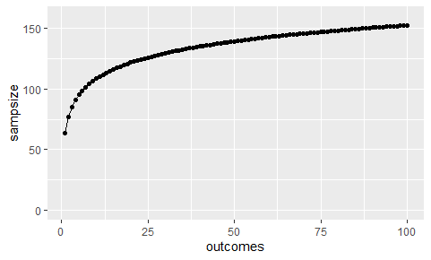
How does sample size change with number of outcomes?
If Bonferroni correction: For N outcomes, critical p divided by N:
(we can easily change sig.level in pwr.t.test() to find out)
For example, if we need N=60 for one outcome…

Slide 73
‘Omics studies
Characterised by:
Many (hundreds/thousands) of possible outcomes/predictors
Each considered equally
Hence many hypotheses being tested
FDR or very low critical p-values to make discoveries
Possibly multivariate analysis (eg PCA) for dimension reduction
Difficult to set an ‘important’ effect size to detect…

Slide 74
False discovery rate and q-value
“…we reported features identified as significant at q<0.05 (Benjamini and Hochberg)”
What does it mean? Where does the q-value come from?
Suggested reading:
‘qvalue’ vignette.
http://www.nonlinear.com/support/progenesis/comet/faq/v2.0/pq-values.aspx

Slide 75
Power for ‘omics study
Probability of detecting a difference in any particular feature, while controlling the number of false positives:
Analogous to size: fix the rate of false positives you are willing to accept (FDR)
Analogous to power: proportion of true positives you want to be able to detect (average power)
Set a target effect size (Cohen’s d) for detection of each feature
Make sure your design matches the design being applied by the sample size calculator.

Slide 76
Approaches to multiplicity
First: be as targeted with hypotheses as is possible
If not possible, or in addition, select a ‘Family Wide Error Rate’ or ‘False Discovery Rate’ approach to type I error.
FDR: the proportion of discoveries that are false is (say) q<0.05
FWER: the probability of making at least one false positive discovery is (say) p<0.05
Applies to exploratory ‘omics’ research and all other multiple outcome studies

Slide 77
Benjamini-Hochberg correction
You don’t know the critical p-value threshold until you have the data
But you can make an educated guess at where it will be
Eg:
But if I expect to detect 10 ‘significant’ genes out of say 1000, then to control FDR at 0.05 I will have a critical p-value of
0.05 * 10 / 1000 = 0.0005
I can plug this into my regular power calculation to get a rough expected sample size for a given effect size and power.

Slide 78
Gene expression microarray analysis / Differential abundance analysis
Very small sample size, many quantitative measures per sample.
One or more phenotypes and treatments, many different designs possible
Aim: Identify which genes/OTUs differ between groups
Outcome: Fold change in expression/abundance for each feature
Analysis:
Linear model for each gene expression or OTU abundance (eg edgeR) or non-parametric test (eg Mann-Whitney)
‘FDR’ approach to multiplicity correction for p-values.
Power and sample size:
How do you interpret power and sample size?
What does power mean in this context?

Slide 79
Microarray studies (1)
Several approaches depending on complexity of prior knowledge and study design
Simplest approach:
Assume all genes/taxa have the same s.d.
Fix the expected number of false positives you expect
Choose an acceptable average power for genes
as implemented in sizepower Bioconductor package: equiv. to fixing Cohens’s d to be the same for each gene
Lee, M.-L. T. and Whitmore, G. A. Power and sample size for DNA microarraystudies. Statistics in Medicine, 21:3543–3570, 2002.

Slide 80
From the ‘sizepower’ vignette:
Require power of 90%
Allow: one false positive on aberage
R> sampleSize.randomized(ER0=1, G0=2000, power=0.9, absMu1=1, sigmad=0.566)
$n[1] 8
$d[1] 1.766784
True effect is 1.0
SD of expression is 0.566
2000 not-differently expressed genes
Read the paper or the vignette before you try to apply this!

Slide 81
Microarray studies – (2) a bit more complex
Not every gene will have the same s.d.
S.d.’s are all different implies different sample size needed for each gene.
If we know the s.d.’s from similar work in the same system
then rather than fixing Cohens d, we can fix the target fold change, and look at the proportion of genes we can detect with a fixed level of power.
Implemented by ssize package in Bioconductor.

Slide 82
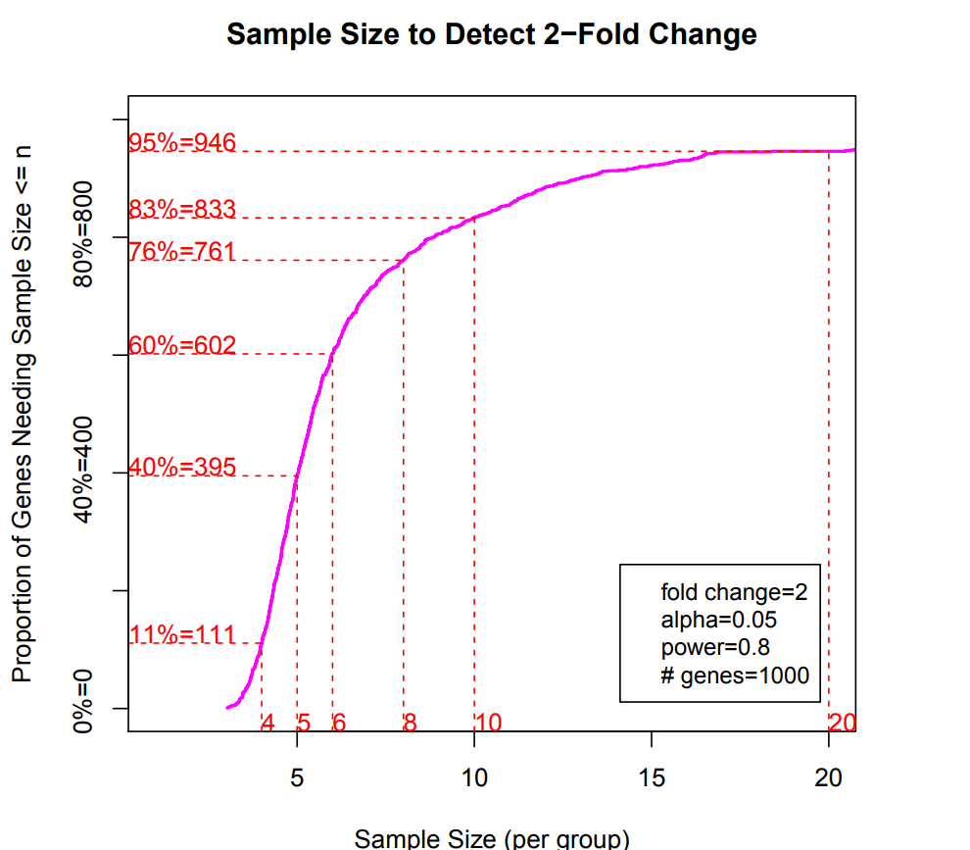
Proportion of differentially expressed genes detectable at each sample size
From ssize Bioconductor R package
Need to know:
Distribution of standard deviations of log-fold change
‘ssize’ vignette for more details

Slide 83
Microbiome sample size analysis
If you are targeting a small number of parameters
Diversity, richness etc (single continuous variable)
Prevalence of specific species (proportion)
Existence of specific species (binary outcome)
Or by dimension reduction (say comparison of first or second PCs)
Etc..
Then any of the earlier methods (for simple outcomes) apply.
For exploratory differential abundance analysis
Apply a correction (eg Benjamini-Hochberg) to p-value and proceed as above
Or apply the logic of gene expression power calcs (previous slides)
Or use a simulation (next slides)

Slide 84
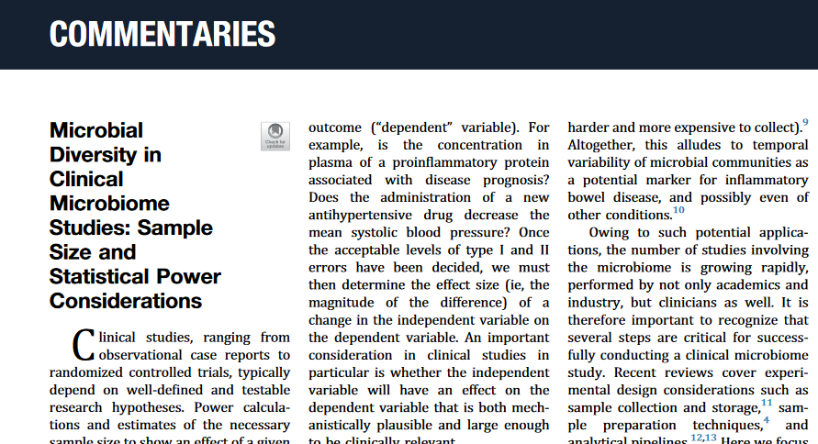
Casals-Pascual et al (2020) Gastroenterology 158:1524-8

Slide 85
Simulating power calculations for microbiome studies
Similar to our exercises earlier:
Simulate datasets similar to the data you will generate in your experiment:
Make perturbations of the type you want to be able to detect
See what proportion of the changes you can detect at various sample sizes

Slide 86
Power and sample size for microbiomes
Systematic review – only four relevant papers presenting methods!
Analytic methods:
Follow a similar process to microarray studies
Simulation methods:
Create a realistic dataset and add realistic differences to it
Try to recover the true differences with different sample sizes

Slide 87
More complex designs
There are lots of resources on sample size calculations for different designs
Make sure you understand what each is doing, and that it matches the problem you are trying to solve, your priorities for your experiment, your design, your analysis plan and expectations about the findings..
It won’t be perfect but will be a reasonable ballpark guide

Slide 88
Session 5 How to need fewer samples

Slide 89
How to reduce required sample size in a research study
Reduce noise in outcome measure
Better outcome measure (more proximal to intervention / less noisy?)
More careful sampling of units, control of experimental parameters (less representative)
Use a more efficient design or analysis
Pairing samples. Consider balance between groups
Consider Adaptive design or Sequential testing? Dropping arms when not needed? (https://journals.plos.org/plosbiology/article?id=10.1371/journal.pbio.2001307)
Design properly (use eg an experimental design assistant)
Reduce number of hypotheses being tested
Do fewer studies but do better studies
Avoid needless replication. Build consortia. Apply for realistically large grants.
Use meta-analysis
Be realistic about what you can detect.

Slide 90
Less noise or more effect = fewer samples needed
Reduce noise in outcome measure:
Use an outcome that is more proximal to your intervention? (as phase II drug trials often will use biomarkers rather than clinical outcomes)
Use a composite outcome? Or an outcome that is more reliable? (eg objective vs subjective? Repeat measurements?)
More careful sampling of units, reduce heterogeneity in sample population (at possible cost to generalisability)

Slide 91
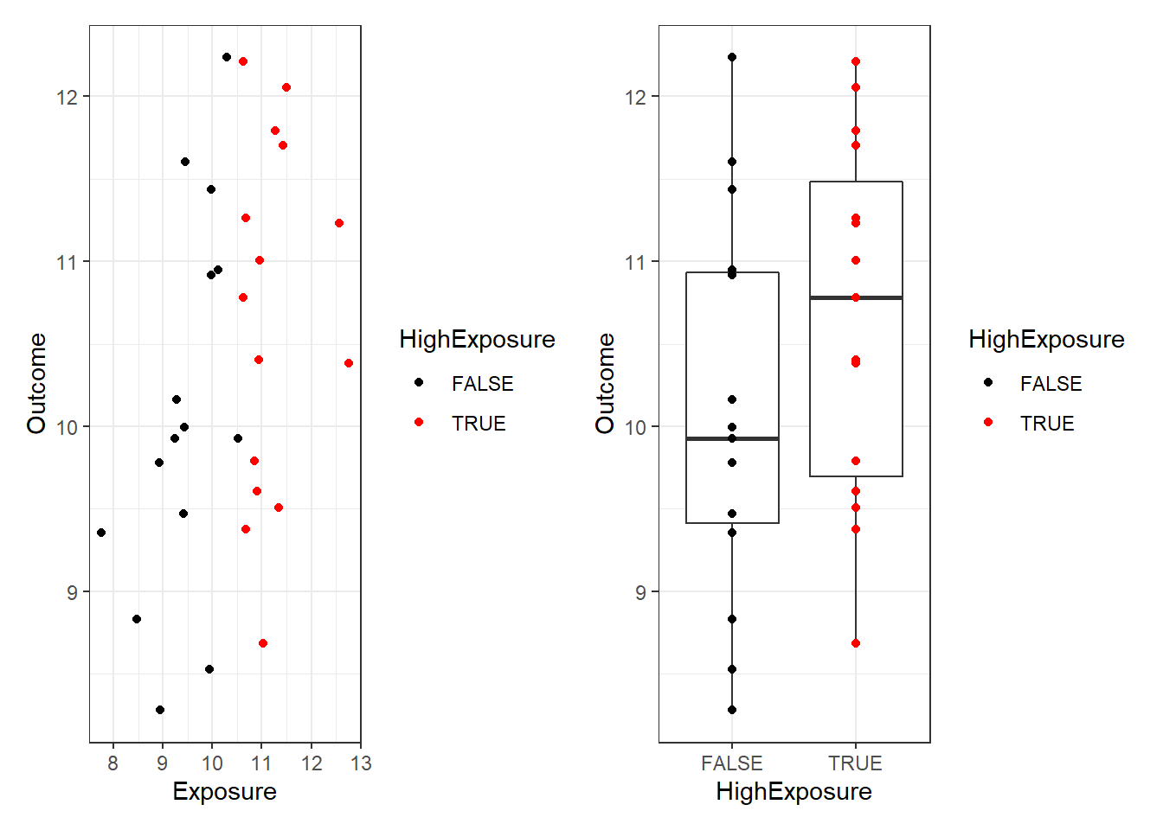
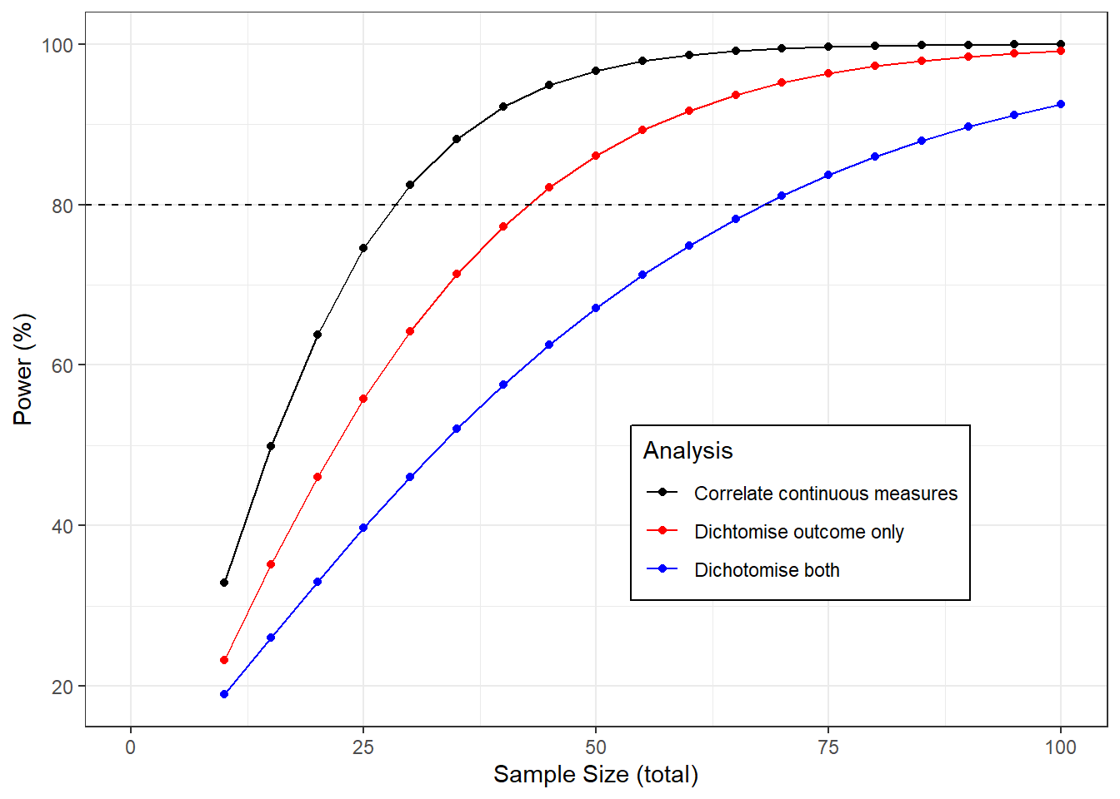
Do not dichotomise your continuous measures
https://georgemsavva.github.io/R_for_Statistics/dichot.html

Slide 92
Change your design
Consider pairing, or repeated measures analysis to remove variance (eg cross-over study)
Blocking or minimisation to ensure balance across treatment groups
Carefully Consider whether all groups are really necessary
Might pre-post meet your objective rather than between groups?
Consider using a factorial design rather than multiple arms
Go on the experimental design and analysis course or read a book on design appropriate to your field!

Slide 93
Consider trying to increase the treatment effect:
A larger effect size is easier to detect.
If you’re just trying to show that an effect exists *at all* then inducing the largest possible effect by increasing the treatment, the duration, or by reducing the number of treatment levels might help.

Slide 94
Factorial designs can be more efficient!
Consider testing effect of 2 factors, A and B, with 24 observations:
Factorial design with four groups:
Control, Treat A, Treat B, Treat A+B
Three groups: Control, Treat A, Treat B
Control
N=6
A
N=6
Control
N=8
A
N=8
B
N=8
B
N=6
A + B
N=6
Effect of factor A: A vs control
N=16
We’re wasting the 8 “Group B” observations here!
Effect of treat A:
(A and A+B) vs (control and B only)
All 24 observations used!
50% more data for the same total sample size!

Slide 95
Consider adaptive design (design that changes as we go)
Clinical trials are very resource intensive, triallists have come up with lots of ways to save money but still be robust:
Eg carefully planned group sequential design: (need to adjust p-value threshold to allow possibility of stopping the study early)
N=10
Unsure
N=10
Unsure
N=10
AcceptH0
Reject H0
AcceptH0
Reject H0
AcceptH0
Reject H0

Slide 96
Conduct fewer primary studies
Many studies are a waste of time:
Answering questions we already know the answers to
Answering questions we don’t care about
Generating data or materials we already have elsewhere
Answering questions badly or
Conducting studies that have no hope of meetings their objectives
What might you do?
Start with a systematic review
Speak to users / end users
Use existing data where possible
Pool resources, build consortia to apply for bigger (realistic) grants
Don’t tackle impossible questions

Slide 97
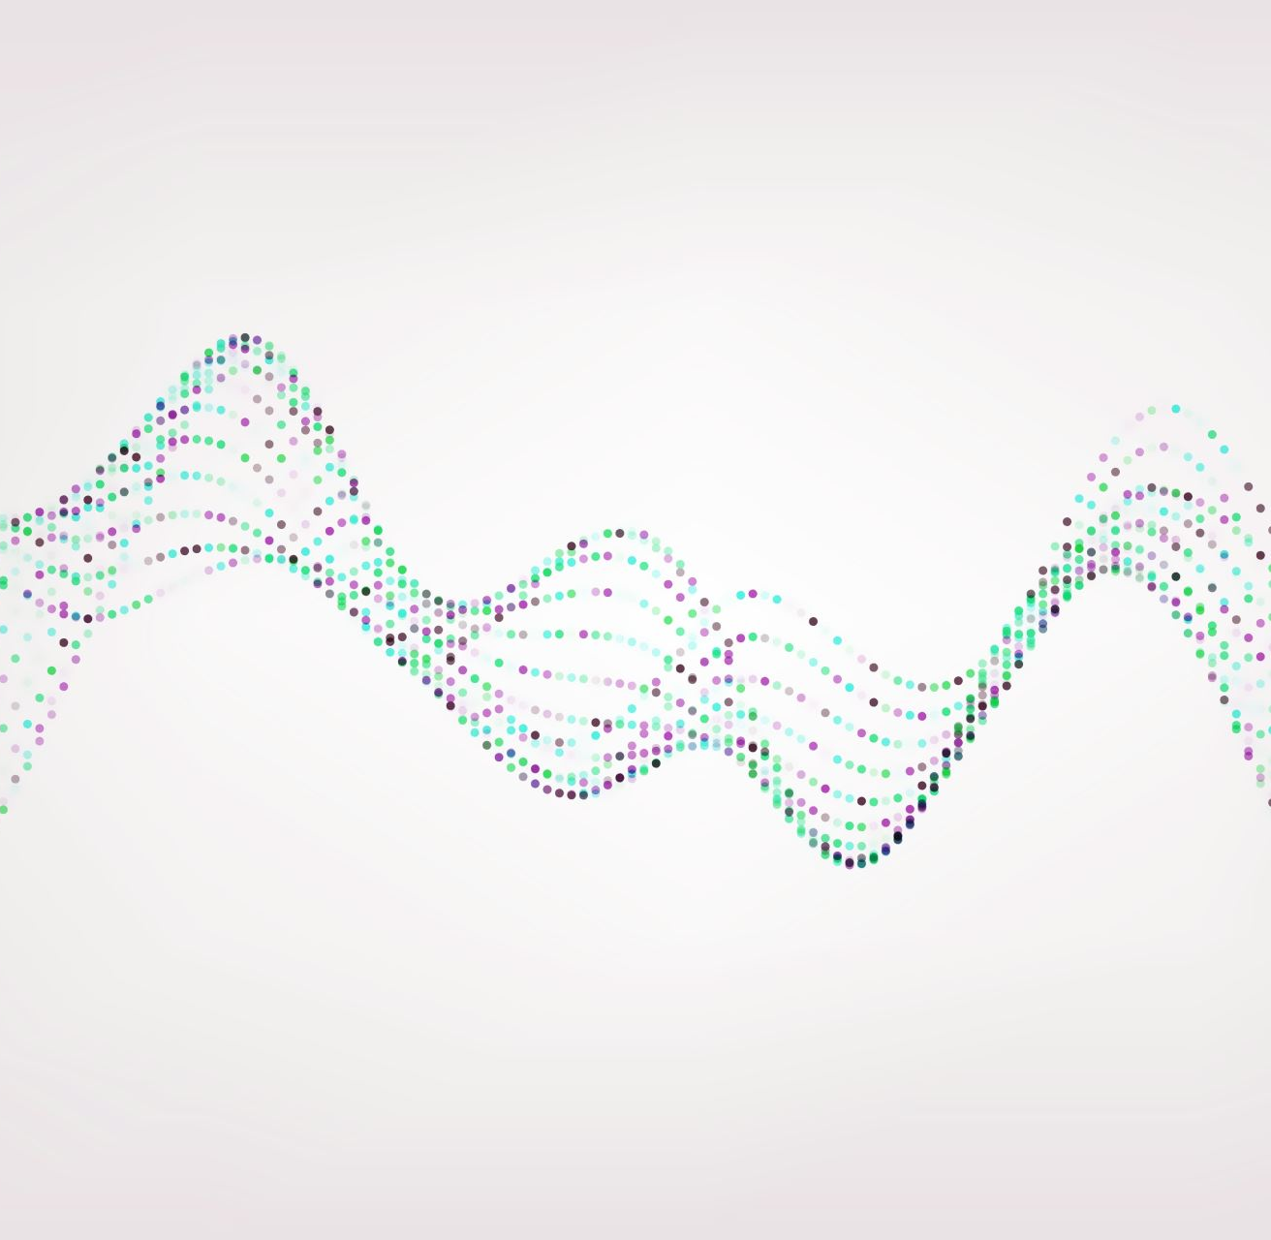
Final words
Extracts from conversations between the scientist and the statistician

Slide 98
“It’s OK if we’re underpowered, the more things we test, the more chance we’ll find something!” - Anonymous RL
Hopefully I don’t need to explain this one?
Success or failure shouldn’t be judged on whether or not you ‘find something’. It should be about how precisely and robustly you answered your original research question.
More tests = more false positives
P-value thresholds must be corrected downward
If you genuinely have a multiplicity of outcomes, plan for this appropriately.

Slide 99
“But we always use N=3!”
Each experiment has its own objectives, its own parameters, its own sources of variance
Copying a previous design without considering your own needs risks underpowering or overpowering

Slide 100
“But [previous work] got p=0.048 with 3 mice! Why do I need 8?”
Previous work is a useful source of information for calculating sample size
But remember: results of scientific experiments are random
Most published work over-estimates effects and under-estimates variance
And If p=0.048 in a previous study, then the power for that study was almost exactly 50%. Can you think why?
So you can conclude the original study was underpowered and they got ‘lucky’ or likely to be a false positive, but in any case, you need more than they did.
(A p-value of 0.005 corresponds to 80% power at p=0.05)

Slide 101
“Its OK, we’ll repeat the experiment to confirm it afterwards”
What are you really doing here? What do you learn from doing this repeat?
Why don’t you believe the first experiment? Fix the issue?
If you repeat an underpowered experiment, your chance of success is low even if the effect is real.
If you repeat a properly powered experiment, then you’ve wasted your time.
By analysing individually you miss out on the benefits of the repeats!
What you are really doing is a weird two-stage design (how do you get your effect estimates?). Difficult to understand the statistical properties of this.
Design it properly to begin with?

Slide 102
The ‘it’s OK we’ll repeat it afterwards’ design
Test 1
Test 2
Success!
☺
p<0.05
p<0.05
Power=80%
(ok but I don’t trust myself)
Power=80%
(well that settles it)
p>0.05
(nothing there)
p>0.05
(must have been a fluke or something)
Failure
☹
Consider what we learnt about repeatability of studies from the first session.
If you have enough samples for two experiments, then run two studies or a proper adaptive design.
What is the power and size of this design?
Power = 64%
Size = 0.0025
Was this the intention?

Slide 103
“I don’t care how different, I just want to show they are different…”
An argument against needing to think about minimum important differences.
Reasonable on the face of it…
But…
…given enough data, null hypothesis is always false
That is, every intervention makes at least some difference to an outcome.

Slide 104
“If we see an effect even in an underpowered study, then it must be real” - me in less enlightened times
Sort of intuitively correct?
But NO!
We have seen that underpowered studies are more likely to throw false positives
A very large observed effect is highly likely to be a false positive if your prior belief is that the true effect is small..

Slide 105
“My grant is due next week, I’m using five mice, can I have a power calculation to justify this?”
Previously: I have misgivings about this but I’ll see what I can do.
In future: No.
When in your project planning process should you think about sample size?
Keep in mind from the earliest stages of planning
Not 2 weeks before a grant deadline when all the costs are already done and you’re up to budget.
Not 6 months into your PhD project – what if it’s not feasible?
But do revisit at those times and whenever design decisions are being taken!

Slide 106
Take home messages
Conducting underpowered studies is a waste of time and resources.
An unethical waste in the case of animal and human studies
Conducting sample size calculation requires you to think through your research questions, design and analysis
Plans are useless – planning is essential
Broadly speaking – sample size depends on:
Your willingness to accept false positives and negatives
At a given ratio of ‘signal’ to ‘noise’ in your experiment.
To detect a smaller signal -> more numbers
With more ‘noisy’ experiment -> more numbers
It isn’t an exact science, so consider a range of inputs
The principle is the same, but is operationalised differently for different designs and research questions.

Slide 107
Thanks
Questions
Feedback

